Slide 1

T Infrastructure: Hardware and Software
Chapter 5
Ali Bazarah
MIS 300

Slide 2
Learning Objectives
5.1 What are the components of I T infrastructure?
5.2 What are the major computer hardware, data storage, input, and output technologies used in business and the major hardware trends?
5.3 What are the major types of computer software used in business and the major software trends?
5.4 What are the principal issues in managing hardware and software technology?

Slide 3
Infrastructure Components
I T infrastructure
Platform for supporting all information systems in the business
Hardware: Input, processing, output, storage, and delivery
Software: System software, application software, and enterprise integration
Data management technology: Organize and deliver data
Networking and telecommunications technology: Data, voice, audio, and video
Technology services: Run and manage infrastructure and train users

Slide 4
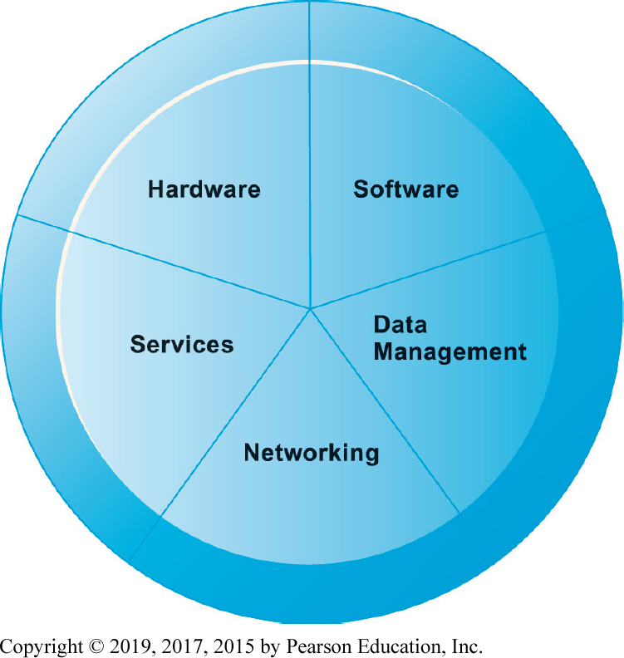
Figure 5.1 I T Infrastructure Components
Notes:
Figure 5.1, Page 158.
A firm’s IT infrastructure is composed of hardware, software, data management technology, networking technology, and technology services.

Slide 5
Types of Computers
Personal computers and mobile devices: Includes desktops, laptops,
Workstations: Has more computing capacity in its CPU to support large graphics files
Servers: Used primarily in networks
Mainframes: Has the necessary power and speed to process thousands and millions of transactions
Supercomputers: Specially designed and more sophisticated computers used for tasks requiring extremely rapid and complex calculations.
Grid computing: Geographically remote computers connected into a single network to create a “virtual supercomputer” by combining the computational power of all computers on the grid.

Slide 6
Client/Server Computing
Form of distributed computing
Splits processing between “clients” and “servers”
each machine is assigned functions it is best suited to perform.
Two-tiered client/server architecture
It consists of a client computer networked to a server computer
Multi-tiered client/server architecture (N-tier)
Web servers
Application servers

Slide 7
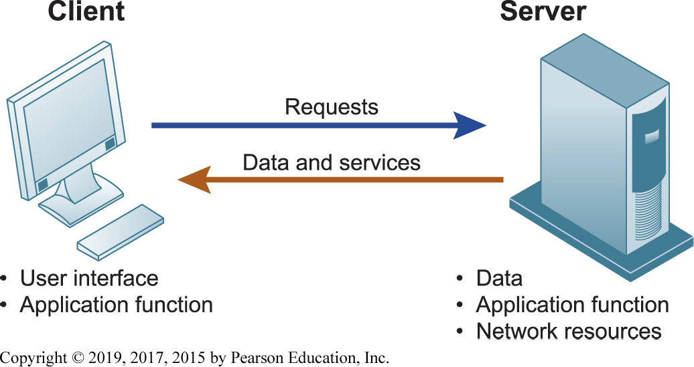
Figure 5.2 Client/Server Computing
Notes:
Figure 5.2, Page 160.
In client/server computing, computer processing is split between client machines and server machines linked by a network. Users interface with the client machines.

Slide 8
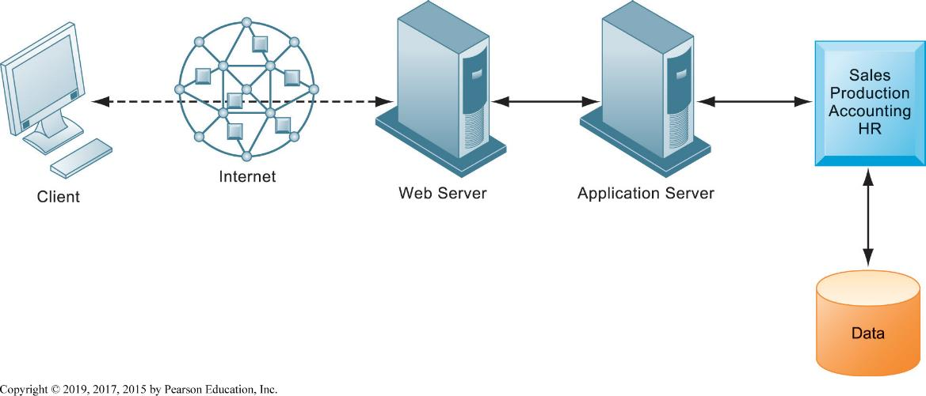
Figure 5.3 A Multitiered Client/Server Network (N-Tier)
Notes:
Figure 5.3, Page 161.
In a multitiered client/server network, client requests for service are handled by different levels of servers.

Slide 9
Storage, Input, and Output Technology
Primary secondary storage technologies
Magnetic disk
Solid state drives S S D s
Optical disks
Magnetic tape
Input devices
E.g. keyboard
Output devices
E.g. monitor

Slide 10
Contemporary Hardware Trends
Cloud computing:
Computing resources obtained over the Internet
Infrastructure as a service (IaaS): Allows customers to process and store data, and use networking and other resources available from the cloud.
Software as a service (SaaS): The vendor provides software programs on a subscription fee basis. Google apps is a great example of cloud software as a service.
Platform as a service (PaaS): The service provider offers infrastructure and programming tools to customers so they can develop and test applications.
Public vs. private clouds
Hybrid cloud
Data storage security is in hands of provider

Slide 11
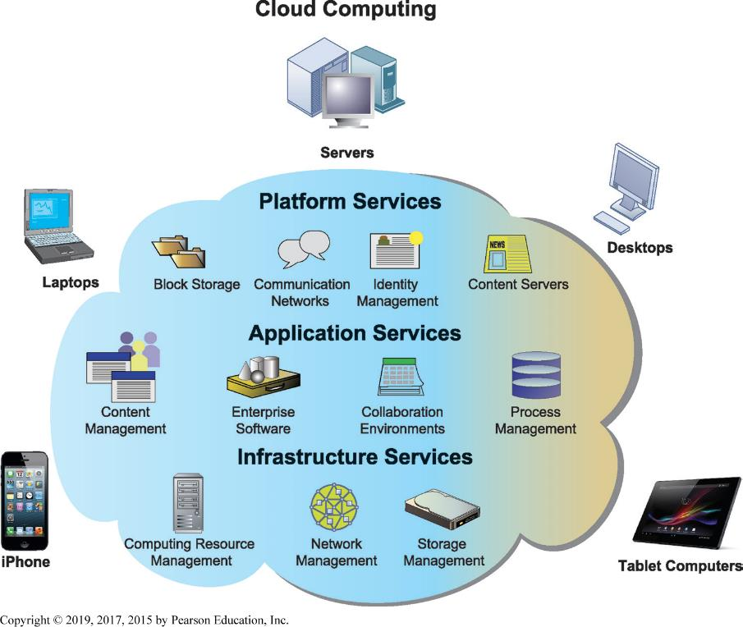
Figure 5.4 Cloud Computing Platform
Notes:
Figure 5.4, Page 166.
In cloud computing, hardware and software capabilities are a pool of virtualized resources provided over a network, often the Internet. Businesses and employees have access to applications and IT infrastructure anywhere and at any time.
The largest operators of cloud computing data centers are Amazon, IBM, Oracle, HP, Apple, and Google.

Slide 12
AWS
https://www.youtube.com/watch?v=jOhbTAU4OPI

Slide 13
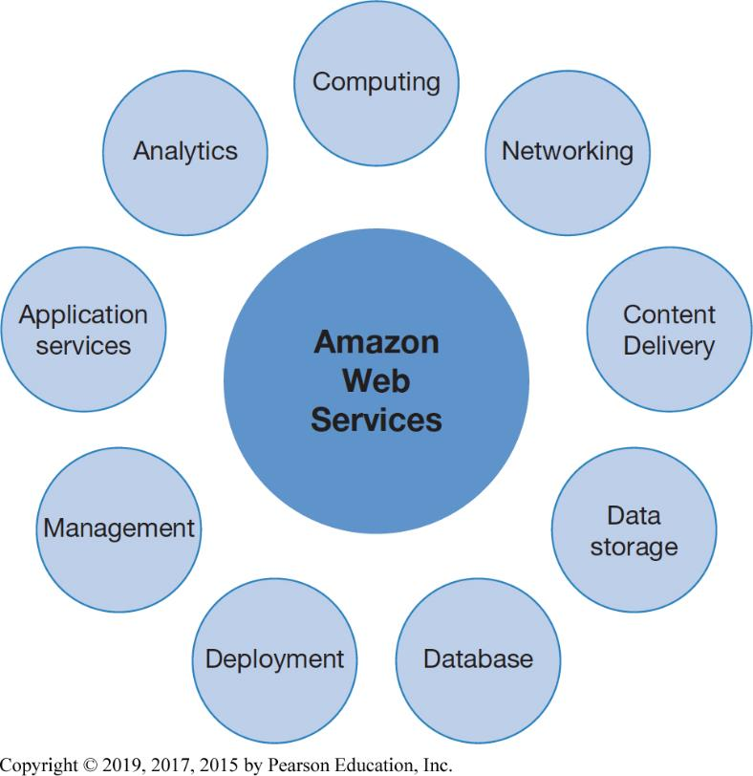
Figure 5.5 Major Amazon Web Services
Notes:
Figure 5.5, Page 167.
Amazon Web Services (AWS) is a collection of web services that Amazon provides to users of its cloud platform. AWS now offers over 90 services and is the largest provider of public cloud-based services.
The largest operators of cloud computing data centers are Amazon, IBM, Oracle, HP, Apple, and Google.

Slide 14
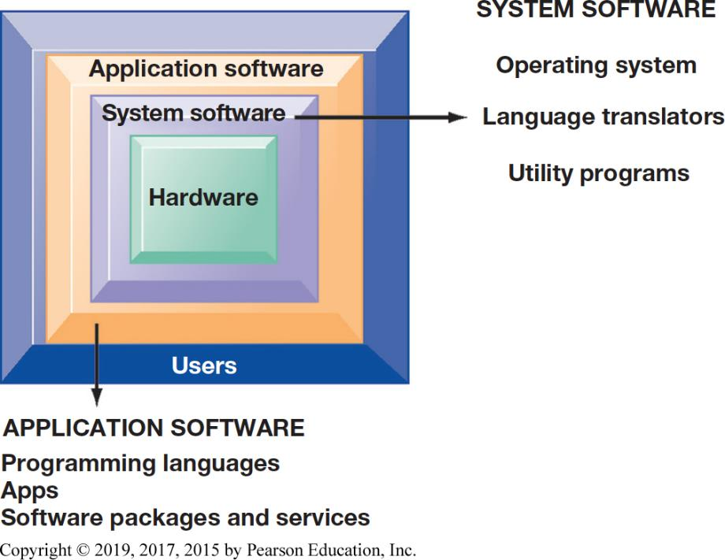
Figure 5.6 The Major Types of Software
Notes:
Figure 5.6, Page 172.
The relationship between the system software, application software, and users can be illustrated by a series of nested boxes. System software—consisting of operating systems, language translators, and utility programs—controls access to the hardware. Application software, including programming languages and software packages, must work through the system software to operate. The user interacts primarily with the application software.

Slide 15
Operating System Software
Software that controls computer activities
Graphical user interface G U I s
Multitouch
P C operating systems
Windows, Mac
UNIX: easier to manage communications and networks
Linux (open source)
Mobile operating systems
Chrome, Android, i O S

Slide 16
Application Software and Desktop Productivity Tools (1 of 2)
Programming languages for business
C
C++ - newer, object-oriented version of C
Visual Basic: Visual programming language for M S Windows applications
Java: is used for building applications that run on the web
Migrated to mobile applications, game machines, cable T V systems
Java Virtual Machine

Slide 17
Application Software and Desktop Productivity Tools (2 of 2)
Software packages and desktop productivity tools
Word processing software
Spreadsheet software
Data management software
Presentation graphics
Software suites
Web browsers

Slide 18
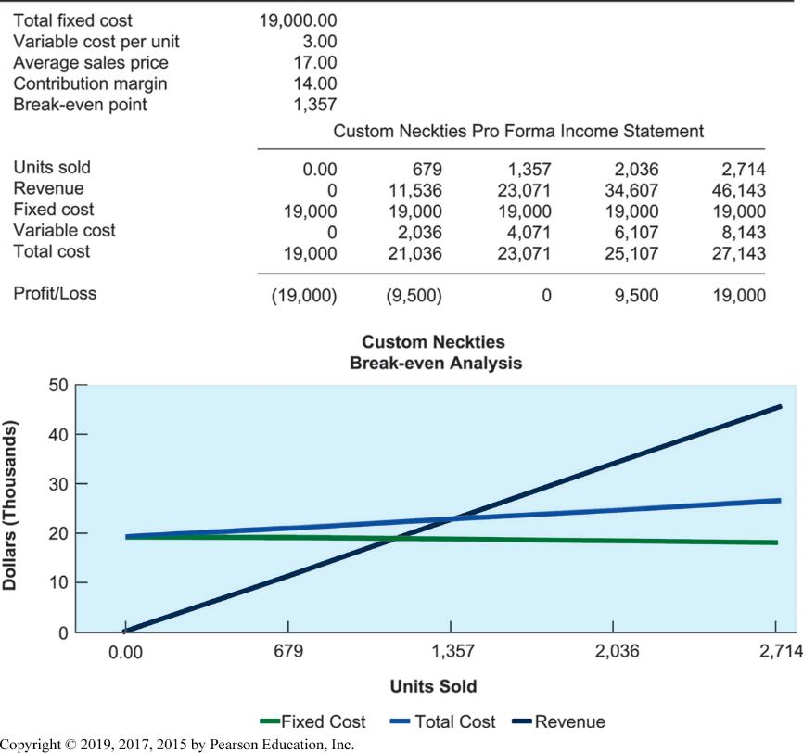
Figure 5.7 Spreadsheet Software
Notes:
Figure 5.7, Page 175.
Spreadsheet software organizes data into columns and rows for analysis and manipulation. Contemporary spreadsheet software provides graphing abilities for a clear, visual representation of the data in the spreadsheets. This sample breakeven analysis is represented as numbers in a spreadsheet as well as a line graph for easy interpretation.

Slide 19
H T M L and H T M L 5
Hypertext markup language (H T M L ):
Page description language for specifying how elements are placed on a web page and for creating links to other pages and objects
H T M L 5
Next evolution of H T M L
Enables multimedia embedding without 3rd party plugins like Flash

Slide 20
Software Trends
Open source software
Linux
Cloud-based software and tools
S a a S (software as a service)
Google Docs
Apps
Mobile apps

Slide 21
Total Cost of Ownership (T C O) model
Analyzing direct and indirect costs to determine the actual cost of owning a specific technology
Direct costs: hardware, software purchase costs
Indirect costs: ongoing administration costs, upgrades, maintenance, etc.
Hidden costs: support staff, downtime, etc.
T C O can be reduced through increased centralization, standardization of hardware and software resources.

Slide 22
Using Technology Service Providers
Outsourcing
Using external provider to run computer center and networks
Offshore software outsourcing
Service level agreements (S L A s)
Using cloud services
Appealing to businesses with smaller I T budgets
Pricing is per hour, per-use

Slide 23
Managing Software Localization for Global Business
Software localization
Local language interfaces
Complex software interfaces
Differences in local cultures
Differences in business processes
These factors add to T C O of using technology service providers

